Slide 1



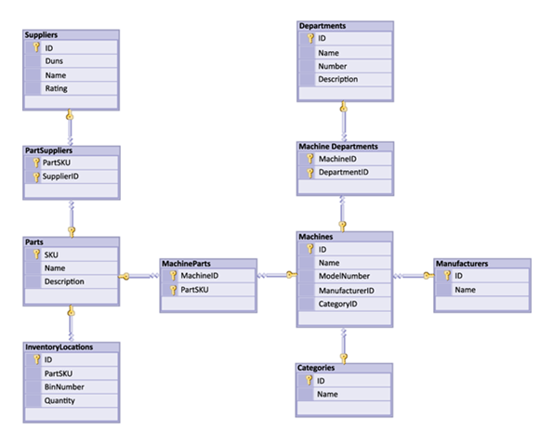


Basic CRUD in SQL Server
Create, Retrieve, Update, Delete
using SQL queries
Basic
CRUD
SoftUni Team
Technical Trainers
Software University
http://softuni.bg

Slide 2

Table of Contents
Query Basics
Retrieving Data
Writing Data
Modifying Existing Records

Slide 3
Questions
sli.do #CSharpDB

Slide 4


Query Basics
SQL and T-SQL Introduction

Slide 5
What are SQL and T-SQL?
Structured Query Language
Declarative language
Close to regular English
Supports definition, manipulation and access control of records
Transact-SQL (T-SQL) – SQL Server's version of SQL
Supports control flow (if statements, loops)
Designed for writing logic inside the database
SELECT FirstName, LastName, JobTitle FROM Employees

Slide 6
SQL – Examples
SELECT FirstName, LastName, JobTitle FROM Employees
SELECT * FROM Projects WHERE StartDate = '1/1/2006'
INSERT INTO Projects(Name, StartDate)
VALUES('Introduction to SQL Course', '1/1/2006')
UPDATE Projects
SET EndDate = '8/31/2006'
WHERE StartDate = '1/1/2006'
DELETE FROM Projects
WHERE StartDate = '1/1/2006'

Slide 7
T-SQL – Example
CREATE PROCEDURE EmpDump AS
DECLARE @EmpId INT, EmpFName NVARCHAR(100),
@EmpLName NVARCHAR(100)
DECLARE emps CURSOR FOR
SELECT EmployeeID, FirstName, LastName FROM Employees
OPEN emps
FETCH NEXT FROM emps INTO @EmpId, @EmpFName, @EmpLName
WHILE (@@FETCH_STATUS = 0)
BEGIN
PRINT CAST(@EmpId AS VARCHAR(10)) + ' '
+ @EmpFName + ' ' + @EmpLName
FETCH NEXT FROM emps INTO @EmpId, @EmpFName, @EmpLName
END
CLOSE emps
DEALLOCATE emps
Variables
Loops

Slide 8

Retrieving Data
Using SQL SELECT

Slide 9
Capabilities of SQL SELECT
Projection
Take a subset of the columns
Selection
Take a subset of the rows
Join
Combine tables by
some column
Table 1
Table 2
Notes:
Capabilities of SQL SELECT Statements
A SELECT statement retrieves information from the database. Using a SELECT statement, you can do the following:
Projection: You can use the projection capability in SQL to choose the columns in a table that you want returned by your query. You can choose as few or as many columns of the table as you require.
Selection: You can use the selection capability in SQL to choose the rows in a table that you want returned by a query. You can use various criteria to restrict the rows that you see.
Joining: You can use the join capability in SQL to bring together data that is stored in different tables by creating a link between them. You learn more about joins in a later lesson.

Slide 10
SELECT – Example
Selecting all columns from the "Departments" table
Selecting specific columns
SELECT * FROM Departments
DepartmentID | Name | ManagerID
1 | Engineering | 12
2 | Tool design | 4
3 | Sales | 273
… | … | …
List of columns
(* for everything)
Table name
DepartmentID | Name
1 | Engineering
2 | Tool design
3 | Sales
… | …
SELECT DepartmentId, Name
FROM Departments
Notes:
Selecting All Columns of All Rows
You can display all columns of data in a table by following the SELECT keyword with an asterisk (*). In the example on the slide, the department table contains five columns: DepartmentID, Name, GroupName, ModifiedDate and rowguid. The table contains 16 rows, one for each department.
You can also display all columns in the table by listing all the columns after the SELECT keyword. For example, the following SQL statement, like the example on the slide, displays all columns and all rows of the Departments table:
SELECT DepartmentID, Name, GroupName, ModifiedDate, rowguid
FROM department;
Selecting Specific Columns of All Rows
You can use the SELECT statement to display specific columns of the table by specifying the column names, separated by commas. The example on the slide displays all the department numbers and location numbers from the Departments table.
In the SELECT clause, specify the columns that you want, in the order in which you want them to appear in the output. For example, to display location before department number going from left to right, you use the following statement:
SELECT DepartmentID, Name
FROM Departments

Slide 11
Column Aliases
Aliases rename a table or a column heading
You can shorten fields or clarify abbreviations
Display Name
SELECT EmployeeID AS ID,
FirstName,
LastName
FROM Employees
ID | FirstName | LastName
1 | Guy | Gilbert
2 | Kevin | Brown
… | … | …
SELECT c.Duration,
c.ACG AS 'Access Control Gateway'
FROM Calls AS c
Notes:
Column Aliases
When displaying the result of a query, SQL Query Analyzer normally uses the name of the selected column as the column heading. For calculations the value usually is “(No column name)”. This heading is not descriptive and hence may be difficult to understand. You can change a column heading by using a column alias.
Specify the alias after the column in the SELECT list using a space as a separator. If the alias contains spaces or special characters (such as # or $), enclose the alias in double quotation marks (" ").

Slide 12
Concatenation Operator
You can concatenate column names using the + operator
String literals are enclosed in single quotes
Column names containing special symbols use brackets
SELECT FirstName + ' ' + LastName AS [Full Name],
EmployeeID AS [No.]
FROM Employees
Full Name | No.
Guy Gilbert | 1
Kevin Brown | 2
… | …
Notes:
Concatenation Operator
You can link columns to other columns, arithmetic expressions, or constant values to create a character expression by using the concatenation operator (+). Columns on either side of the operator are combined to make a single output column.
In the example, FirstName and LastName are concatenated, and they are given the alias FullName. Notice that the employee first name and last name are combined to make a single output column.
The AS keyword before the alias name makes the SELECT clause easier to read.

Slide 13
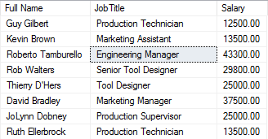
Problem: Employee Summary
Find information about all employees, listing their full name, job title and salary
Use concatenation to display first and last names as one field
Note: Query SoftUni database

Slide 14
Solution: Employee Summary
Concatenation
SELECT FirstName + ' ' + LastName
AS [Full Name],
JobTitle,
Salary
FROM Employees
Column Alias

Slide 15
Filtering the Selected Rows
Use DISTINCT to eliminate duplicate results
Filter rows by specific conditions using the WHERE clause
Other logical operators can be used for greater control
SELECT DISTINCT DepartmentID
FROM Employees
SELECT LastName, DepartmentID
FROM Employees
WHERE DepartmentID = 1
SELECT LastName, Salary FROM Employees
WHERE Salary <= 20000
Notes:
In the example, the SELECT statement retrieves the name and department number of all employees whose department is 1.
Character strings and dates in the WHERE clause must be enclosed in single quotation marks (''). Number constants, however, should not be enclosed in single quotation marks.

Slide 16
Other Comparison Conditions
Combine conditions using NOT, OR, AND and brackets
Using BETWEEN operator to specify a range:
Using IN / NOT IN to specify a set of values:
SELECT LastName FROM Employees
WHERE NOT (ManagerID = 3 OR ManagerID = 4)
SELECT LastName, Salary FROM Employees
WHERE Salary BETWEEN 20000 AND 22000
SELECT FirstName, LastName, ManagerID FROM Employees
WHERE ManagerID IN (109, 3, 16)
Notes:
The BETWEEN Condition
You can display rows based on a range of values using the BETWEEN range condition. The range that you specify contains a lower limit and an upper limit.
The SELECT statement on the slide returns rows from the Employees table for any employee whose base rate is between 40 and 50.
Values specified with the BETWEEN condition are inclusive. You must specify the lower limit first.
The IN Condition
To test for values in a specified set of values, use the IN condition. The IN condition is also known as the membership condition.
The LIKE Condition
You may not always know the exact value to search for. You can select rows that match a character pattern by using the LIKE condition. The character pattern-matching operation is referred to as a wildcard search. Two symbols can be used to construct the search string.
Search conditions can contain either literal characters or numbers:
% denotes zero or many characters.
_ denotes one character.

Slide 17
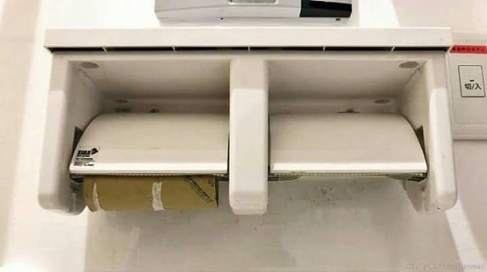
Comparing with NULL
NULL is a special value that means missing value
Not the same as 0 or a blank space
Checking for NULL values
This is always false!
SELECT LastName, ManagerId FROM Employees
WHERE ManagerId = NULL
SELECT LastName, ManagerId FROM Employees
WHERE ManagerId IS NULL
SELECT LastName, ManagerId FROM Employees
WHERE ManagerId IS NOT NULL
Notes:
Null Values
If a row lacks the data value for a particular column, that value is said to be null, or to contain a null.
A null is a value that is unavailable, unassigned, unknown, or inapplicable. A null is not the same as zero or a space. Zero is a number, and a space is a character.
Columns of any data type can contain nulls. However, some constraints, NOT NULL and PRIMARY KEY, prevent nulls from being used in the column.
In the ManagerID column in the Employees table, notice that managers (like Sanchez) have no ManagerID.
If any column value in an arithmetic expression is null, the result is null. For example, if you attempt to perform division with zero, you get an error. However, if you divide a number by null, the result is a null or unknown.

Slide 18

Sorting Result Sets
Sort rows with the ORDER BY clause
ASC: ascending order, default
DESC: descending order
LastName | HireDate
Gilbert | 1998-07-31
Brown | 1999-02-26
Tamburello | 1999-12-12
… | …
SELECT LastName, HireDate
FROM Employees
ORDER BY HireDate
LastName | HireDate
Valdez | 2005-07-01
Tsoflias | 2005-07-01
Abbas | 2005-04-15
… | …
SELECT LastName, HireDate
FROM Employees
ORDER BY HireDate DESC
Notes:
The ORDER BY Clause
The order of rows returned in a query result is undefined. The ORDER BY clause can be used to sort the rows. If you use the ORDER BY clause, it must be the last clause of the SQL statement. You can specify an expression, or an alias, or column position as the sort condition.

Slide 19

Views
Views are named (saved) queries
Simplify complex queries
Limit access to data for certain users
Example: Get employee names and salaries, by department
CREATE VIEW v_EmployeesByDepartment AS
SELECT FirstName + ' ' + LastName AS [Full Name],
Salary
FROM Employees
Executes query
Executes query
SELECT * FROM v_EmployeesByDepartment

Slide 20

Problem: Highest Peak
Create a view that selects all information about the highest peak
Name the view v_HighestPeak
Note: Query Geography database
SELECT * FROM v_HighestPeak

Slide 21
Solution: Highest Peak
TOP(x) selects the first x values
CREATE VIEW v_HighestPeak
AS
SELECT TOP (1) *
FROM Peaks
ORDER BY Elevation DESC
Greatest value first
Sorting column

Slide 22



Writing Data in Tables
Using SQL INSERT

Slide 23
Inserting Data
The SQL INSERT command
Bulk data can be recorded in a single query, separated by comma
Values for
all columns
INSERT INTO Towns VALUES (33, 'Paris')
Specify columns
INSERT INTO Projects (Name, StartDate)
VALUES ('Reflective Jacket', GETDATE())
INSERT INTO EmployeesProjects
VALUES (229, 1),
(229, 2),
(229, 3), …

Slide 24
Inserting Data (2)
List of columns
Inserting rows into existing table:
Using existing records to create a new table:
INSERT INTO Projects (Name, StartDate)
SELECT Name + ' Restructuring', GETDATE()
FROM Departments
SELECT CustomerID, FirstName, Email, Phone
INTO CustomerContacts
FROM Customers
New table name
Existing source

Slide 25
Sequences
Sequences are special object in SQL Server
Similar to IDENTITY fields
Returns an incrementing value every time it’s used
CREATE SEQUENCE seq_Customers_CustomerID AS INT
START WITH 1
INCREMENT BY 1
SELECT NEXT VALUE FOR seq_Customers_CustomerID

Slide 26

Modifying Existing Records
Using SQL UPDATE and DELETE

Slide 27
Deleting Data
Deleting specific rows from a table
Note: Don’t forget the WHERE clause!
Delete all rows from a table (works faster than DELETE):
DELETE FROM Employees WHERE EmployeeID = 1
Condition
TRUNCATE TABLE Users

Slide 28
Updating Data
The SQL UPDATE command
Note: Don’t forget the WHERE clause!
New values
UPDATE Employees
SET LastName = 'Brown'
WHERE EmployeeID = 1
UPDATE Employees
SET Salary = Salary * 1.10,
JobTitle = 'Senior ' + JobTitle
WHERE DepartmentID = 3

Slide 29
Problem: Update Projects
Mark all unfinished Projects as being completed today
Hint: Unfinished projects have their EndDate set to NULL
Note: Query SoftUni database
Name | EndDate
Classic Vest | NULL
HL Touring Frame | NULL
LL Touring Frame | NULL
… | …
Name | EndDate
Classic Vest | 2017-01-23
HL Touring Frame | 2017-01-23
LL Touring Frame | 2017-01-23
… | …

Slide 30
Solution: Update Projects
UPDATE Projects
SET EndDate = '2017-01-23'
WHERE EndDate IS NULL
Filter only records
with no value

Slide 31

Summary
T-SQL is the language of SQL Server
Queries provide a flexible and powerful method to manipulate records
Views allow us to store queries for easier use
SELECT *
FROM Projects
WHERE StartDate = '1/1/2006'

Slide 32







Basic CRUD
https://softuni.bg/courses/databases-basics-ms-sql-server

Slide 33






SoftUni Diamond Partners

Slide 34






SoftUni Diamond Partners

Slide 35
License
This course (slides, examples, demos, videos, homework, etc.) is licensed under the "Creative Commons Attribution-NonCommercial-ShareAlike 4.0 International" license
Attribution: this work may contain portions from
"Databases" course by Telerik Academy under CC-BY-NC-SA license

Slide 36





Trainings @ Software University (SoftUni)
Software University – High-Quality Education, Profession and Job for Software Developers
softuni.bg
Software University Foundation
http://softuni.foundation/
Software University @ Facebook
facebook.com/SoftwareUniversity
Software University Forums
forum.softuni.bg

